Slide 1


Food Pantry Demo
Team 5

Slide 2



Development
Responsive
Secure
User centric
Adaptable design based on device screen size
NodeJS back-end with JWT authorization strategy. Hashed and salted passwords.
App development focused on user needs. Adaptiveness based on user type

Slide 3

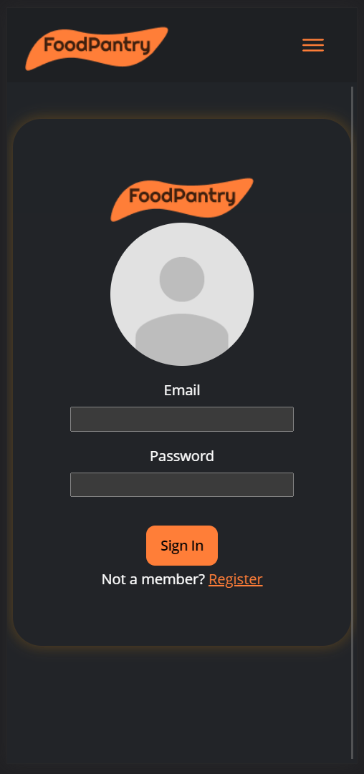
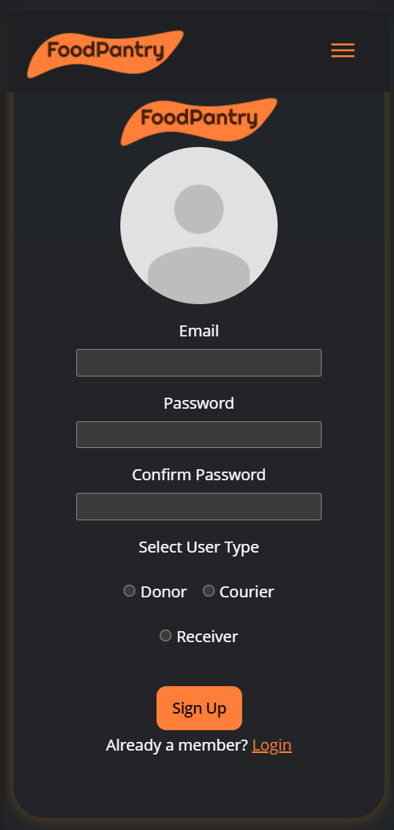
Mobile

Slide 4

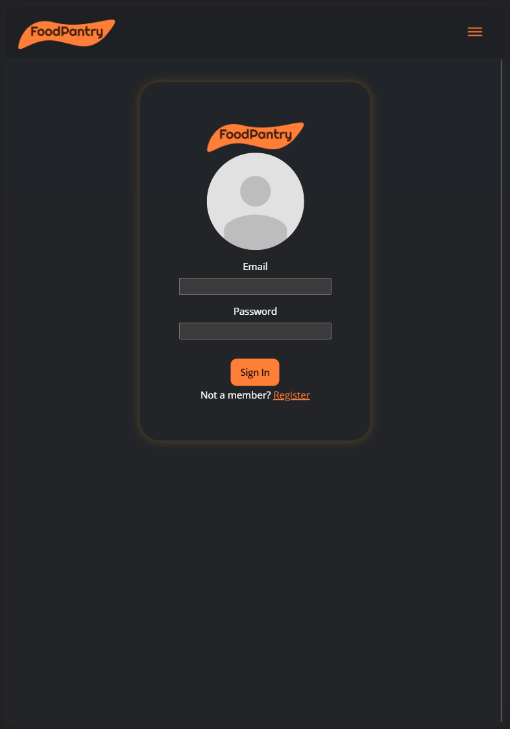
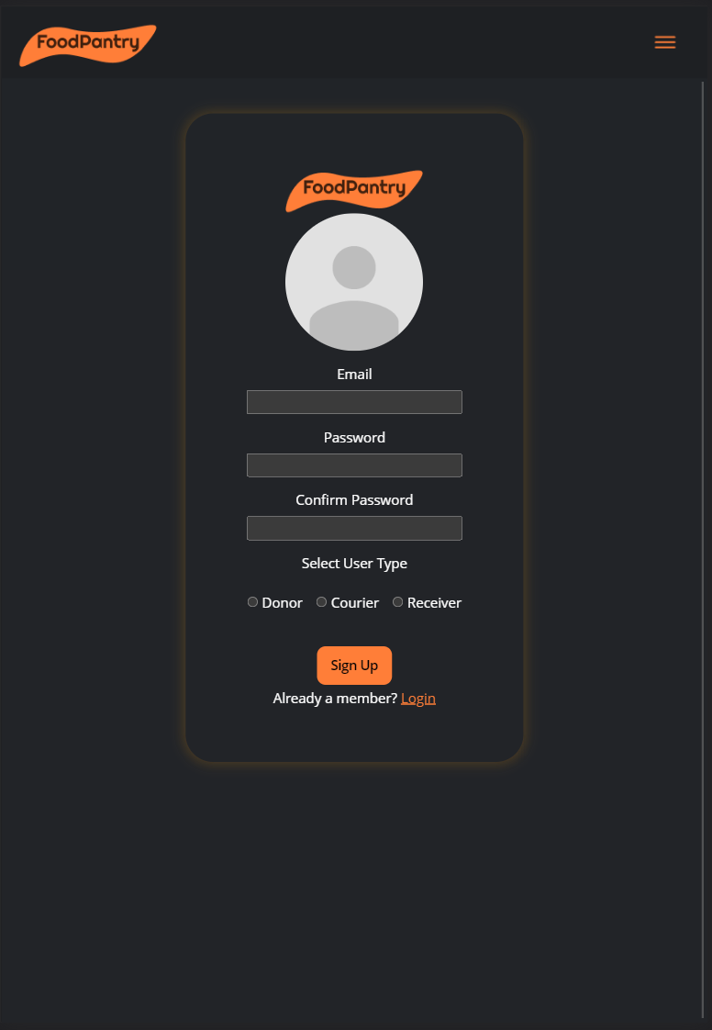
Tablet

Slide 5
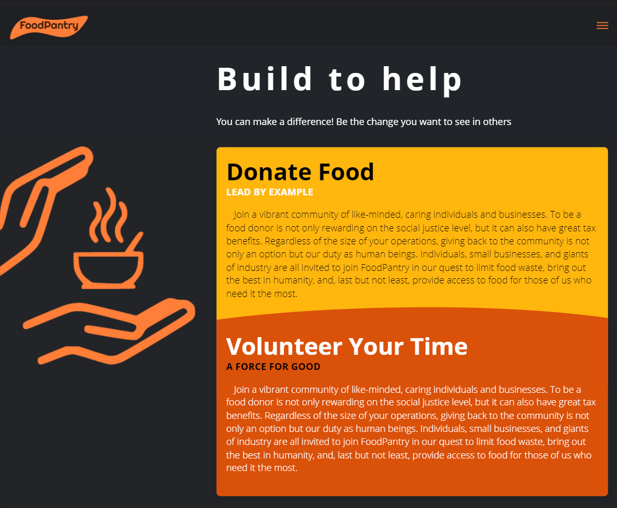
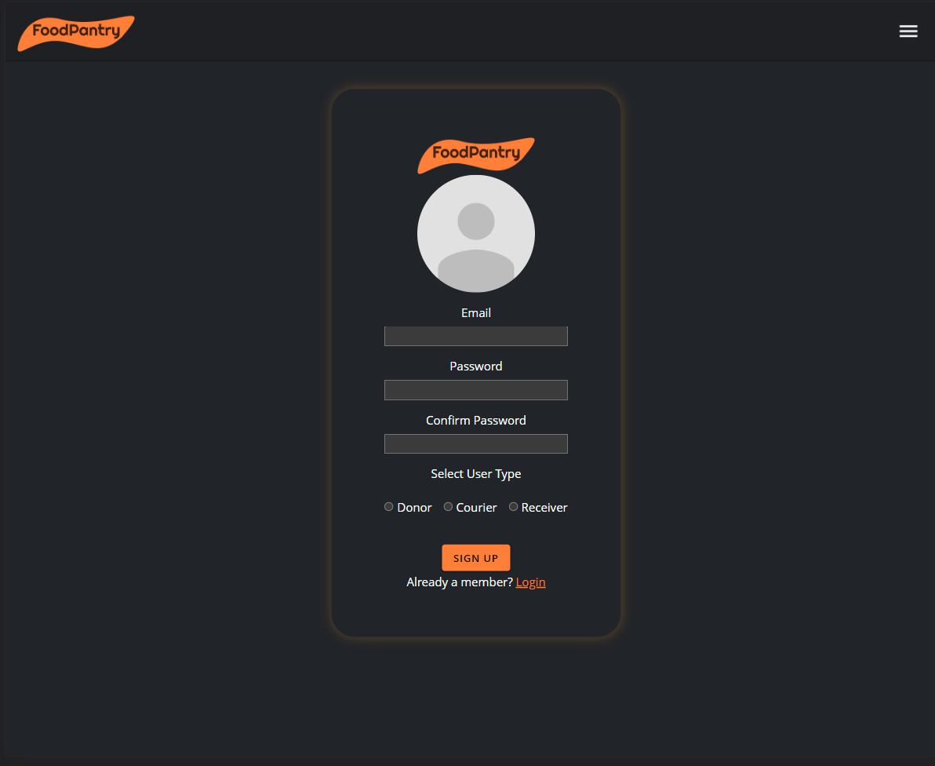
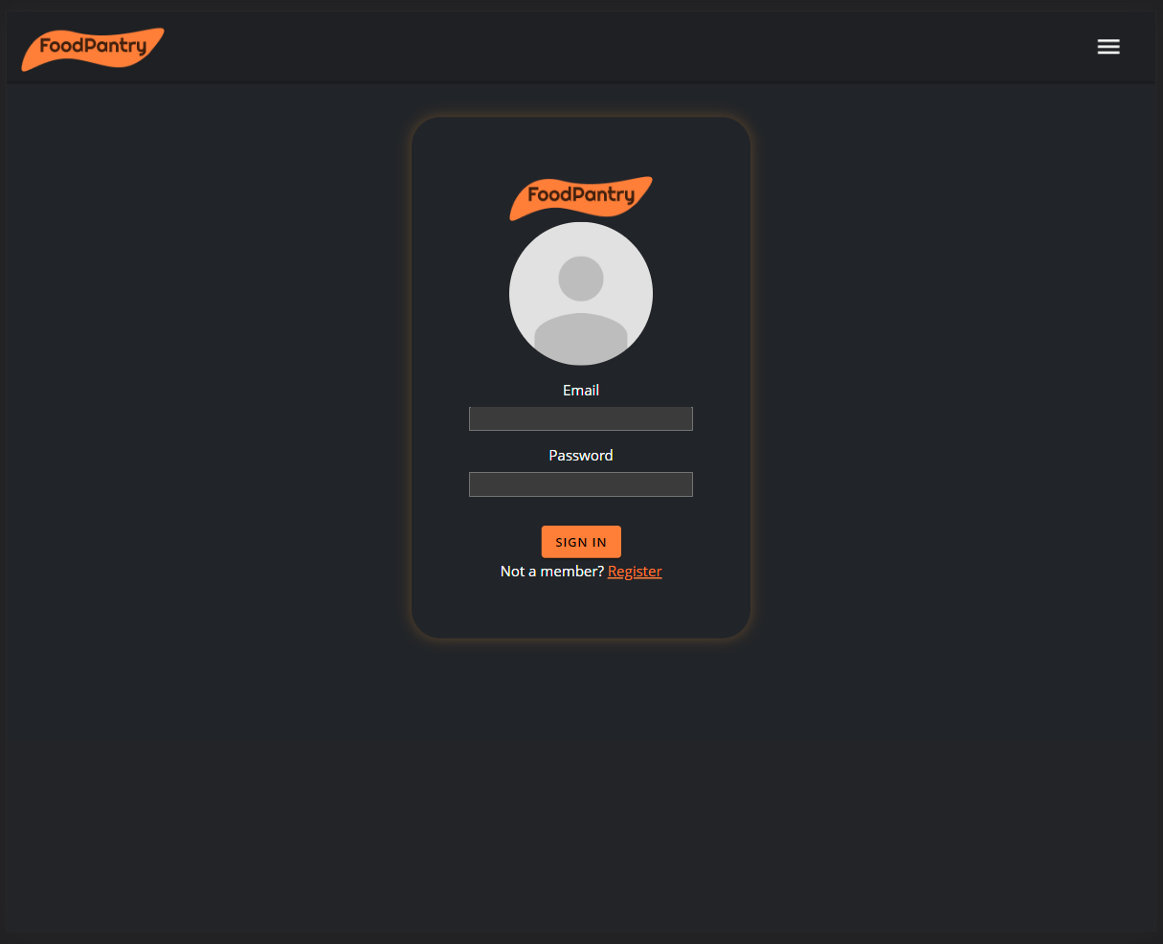
Desktop

Slide 6
Conditional Render
App screens restricted based on user type
Conditional rendering of menu and pages based on permissions

Slide 7
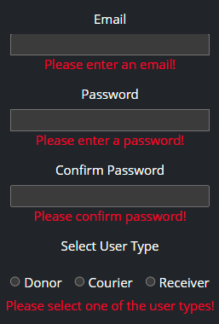
Front-End User Input Validation
Email validation
Password complexity requirements
Password confirmation
Field validation and error messages prior to allowing a HHTTP POST to server

Slide 8
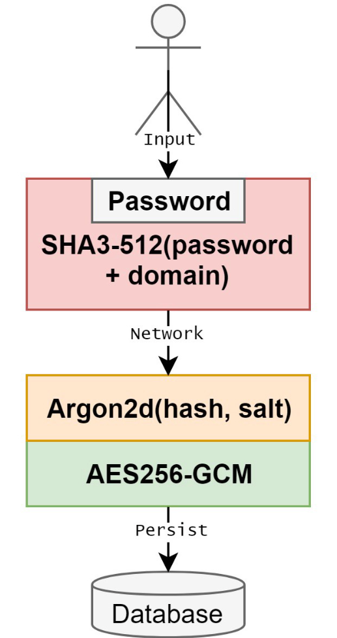
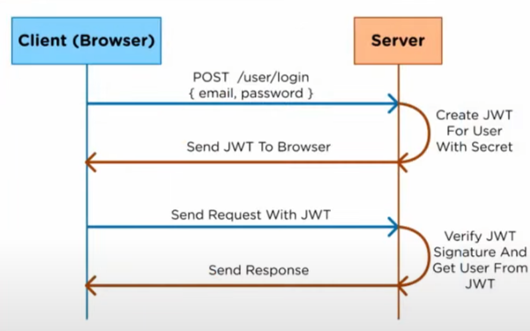
Secure
Username(email) and password authentication
Hashing and salting of password
JWT Auth Strategy of authorization

Slide 9

Demo Video

